Slide 1


Project 2 Framingham Heart Data:
Survival Analysis
Joe Froelicher

Slide 2
Aims
Using the provided Framingham heart data, we are interested in:
determining which risk factors are most associated with increased hazard of having a stroke
determining the 10-year risk for different risk profiles
analyzing how much temporal change in the associated risk factors
and whether a more sophisticated temporal analysis is needed
Risk factors:
four binary categorical variables, presence of cardiovascular disease, smoking status, presence of diabetes, and treatment for hypertension
four continuous risk factors, age, systolic blood pressure, body mass index, and cholesterol level.

Slide 3
Analyses
Univariate Kaplan-Meier Curves for each risk factor
Cox proportional hazards model with backwards selection for 10-year risk profiles
Descriptive statistics of period 1 vs period 2 to analyze change in risk factors over time

Slide 4
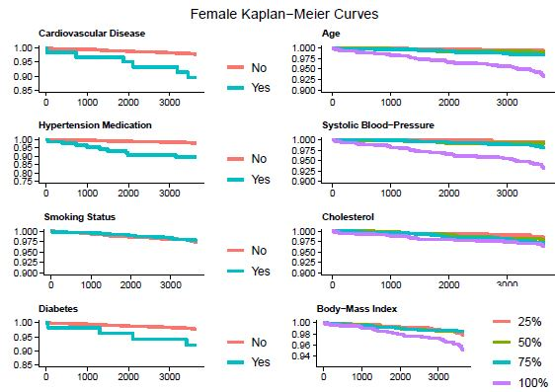
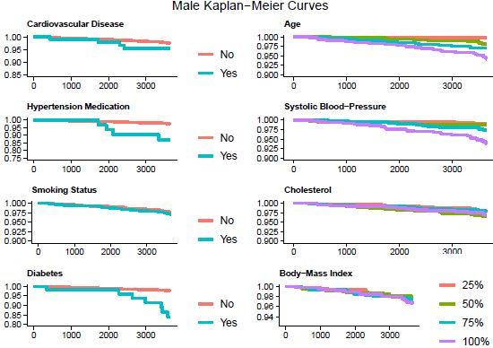
Aim 1a: Kaplan-Meier Curves

Slide 5
Aim 1b: Cox Proportional Hazards
 | Males |  |  |  |  |  | Females
 | coef | HR | se(coef) | P-value | lower | upper | coef | HR | se(coef) | P-value | lower | upper
Age | 0.064 | 1.066 | 0.019 | 0.001 | 1.027 | 1.107 | 0.071 | 1.074 | 0.02 | <0.001 | 1.034 | 1.116
SYS BP | 0.033 | 1.034 | 0.006 | <0.001 | 1.022 | 1.046 | 0.026 | 1.026 | 0.004 | <0.001 | 1.018 | 1.035
Smoke | 0.652 | 1.919 | 0.316 | 0.039 | 1.034 | 3.564 | NA | NA | NA | NA | NA | NA
Diabetes | 1.568 | 4.799 | 0.423 | <0.001 | 2.096 | 10.989 | NA | NA | NA | NA | NA | NA

Slide 6
Aim 2: Risk Factor Change over time
 |  | Females |  | Males
 | level | Period 1 | Period 2 | Period 1 | Period 2
n |  | 2490 | 2239 | 1944 | 1691
age |  | 50.03 ± 8.64 | 55.66 ± 8.56 | 49.79 ± 8.72 | 55.1 ± 8.51
sysbp |  | 133.82 ± 24.46 | 138.06 ± 24.3 | 131.74 ± 19.44 | 135.48 ± 19.9
bpmeds (%) | 0 | 2349 ( 95.8) | 1920 ( 87.7) | 1880 ( 97.8) | 1553 ( 93.9)
 | 1 | 102 ( 4.2) | 270 ( 12.3) | 42 ( 2.2) | 101 ( 6.1)
cursmoke (%) | 0 | 1484 ( 59.6) | 1392 ( 62.2) | 769 ( 39.6) | 811 ( 48.0)
 | 1 | 1006 ( 40.4) | 847 ( 37.8) | 1175 ( 60.4) | 880 ( 52.0)
totchol |  | 239.68 ± 46.22 | 255.67 ± 47.53 | 233.58 ± 42.36 | 241.82 ± 42.14
bmi |  | 25.59 ± 4.56 | 25.65 ± 4.58 | 26.17 ± 3.41 | 26.23 ± 3.4
diabetes (%) | 0 | 2428 ( 97.5) | 2158 ( 96.4) | 1885 ( 97.0) | 1617 ( 95.6)
 | 1 | 62 ( 2.5) | 81 ( 3.6) | 59 ( 3.0) | 74 ( 4.4)
cvd (%) | 0 | 1988 ( 79.8) | 1772 ( 79.1) | 1231 ( 63.3) | 1094 ( 64.7)
 | 1 | 502 ( 20.2) | 467 ( 20.9) | 713 ( 36.7) | 597 ( 35.3)

Slide 7
Implications
Risk factors for stroke males:
Age, Systolic blood pressure, smoking ,and diabetes
Risk factors for stoke females:
Age and systolic blood pressure
Investigate change in blood pressure and age over time (confounder? Mediator?)
Investigate change in smoking over time (coping mechanisms?)
Limitations:
Number of strokes is low (sample size)
Changing risk factors over time

Slide 8

THANK YOU

